Slide 1

Aerosafe Navigator - An Interactive Geospatial Path Simulation with Danger Zone Detection
Mount Carmel College, Autonomous
Bangalore-560052
Department of Computer Science
Name : SNEHA R INTERNAL GUIDE
Register No : M22MC25 Dr. R. DENIS

Slide 2

EXTERNAL GUIDE Mr. DILLI MALANA Deputy General Manager (DGM)

Slide 3
INTRODUCTION
Aerosafe Navigator is an interactive geospatial path simulation tool designed to track and manage the movement of objects, such as airplanes, on a digital map.
The primary focus is on real-time path simulation and visualization, along with the ability to detect and respond to potential threats or danger zones along the route.
This application offers a user-friendly interface, allowing users to interact with the simulation by setting waypoints through map clicks and adjusting speed parameters for the moving object.
An advanced feature enables users to browse and load danger zone files, allowing for dynamic replotting and real-time display of potential hazards.
Alerts are provided to ensure users are continuously informed of proximity to danger zones, enhancing safety and situational awareness throughout the simulation.

Slide 4
FEATURES
What was Done in Review 1:
Speed Selection
Loaded Map Window with Predefined Danger Zones
Creation of Path Markers/Path using Clipboard Contents and Load Lat Lon Button
Simulation Control (Start,Stop) and Danger Zone Detection
Clear Path and Undo Path

Slide 5
Implementation of Features After Review 1:
Animation of Airplane (with respect to path drawn)
Browse File (Loads the user-defined danger zones)
User Authentication (Login Page)
Detecting of Overlapping Danger Zones
GUI Enhancements (Pre-defined Warning Messages)
Lat Lon Text File (File stores the lat lon of the path drawn with current date)
Save and Retrieve Button (Saves screenshots of path drawn and retrieves the saved screenshot)
What to be Implemented:
Save and Retrieve Button (Screenshots to be saved and retrieved from this application itself)

Slide 6
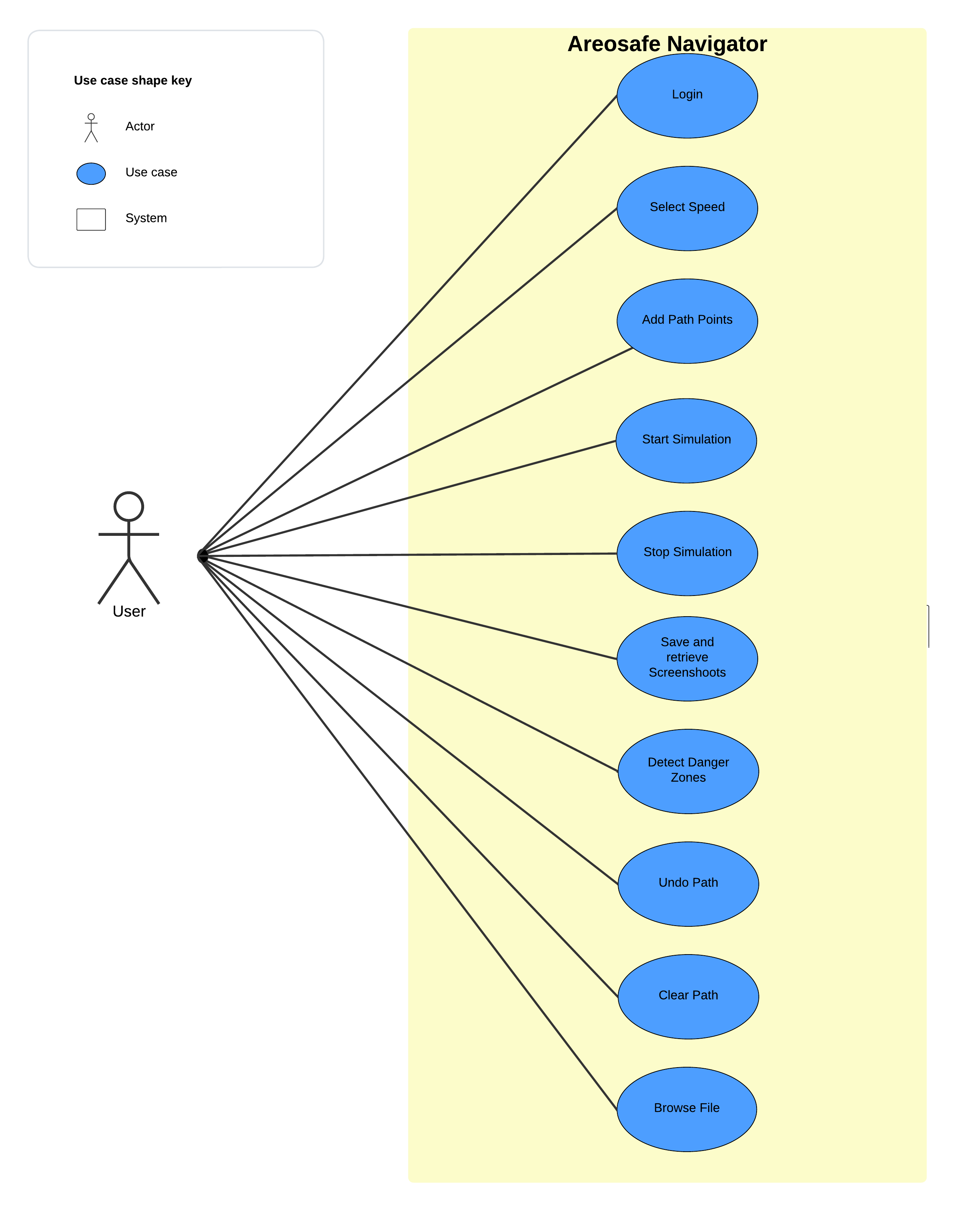
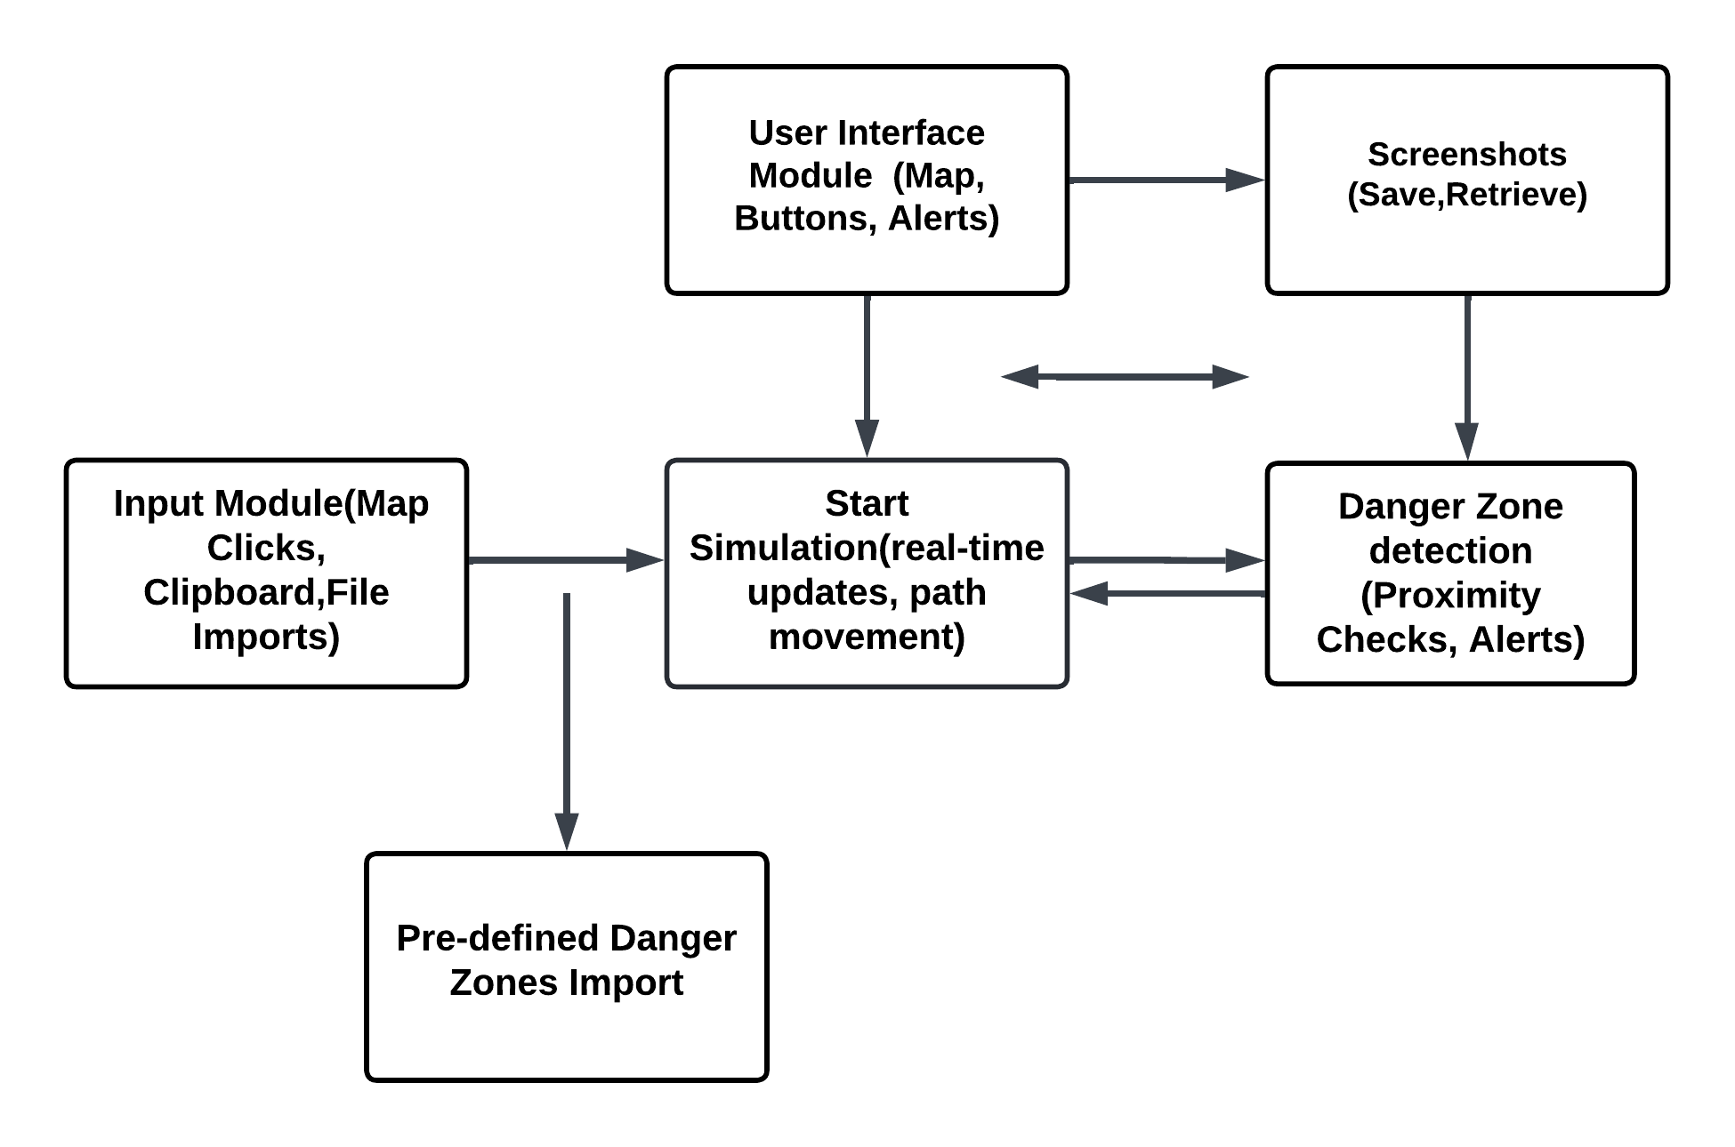
BLOCK DIAGRAM
USE CASE DIAGRAM

Slide 7
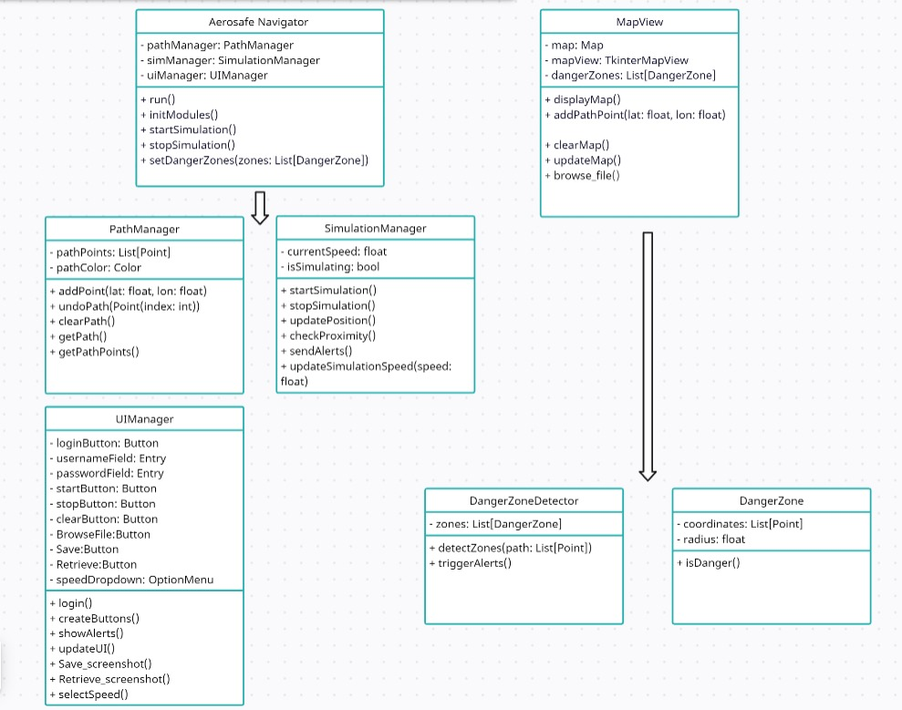
CLASS DIAGRAM

Slide 8
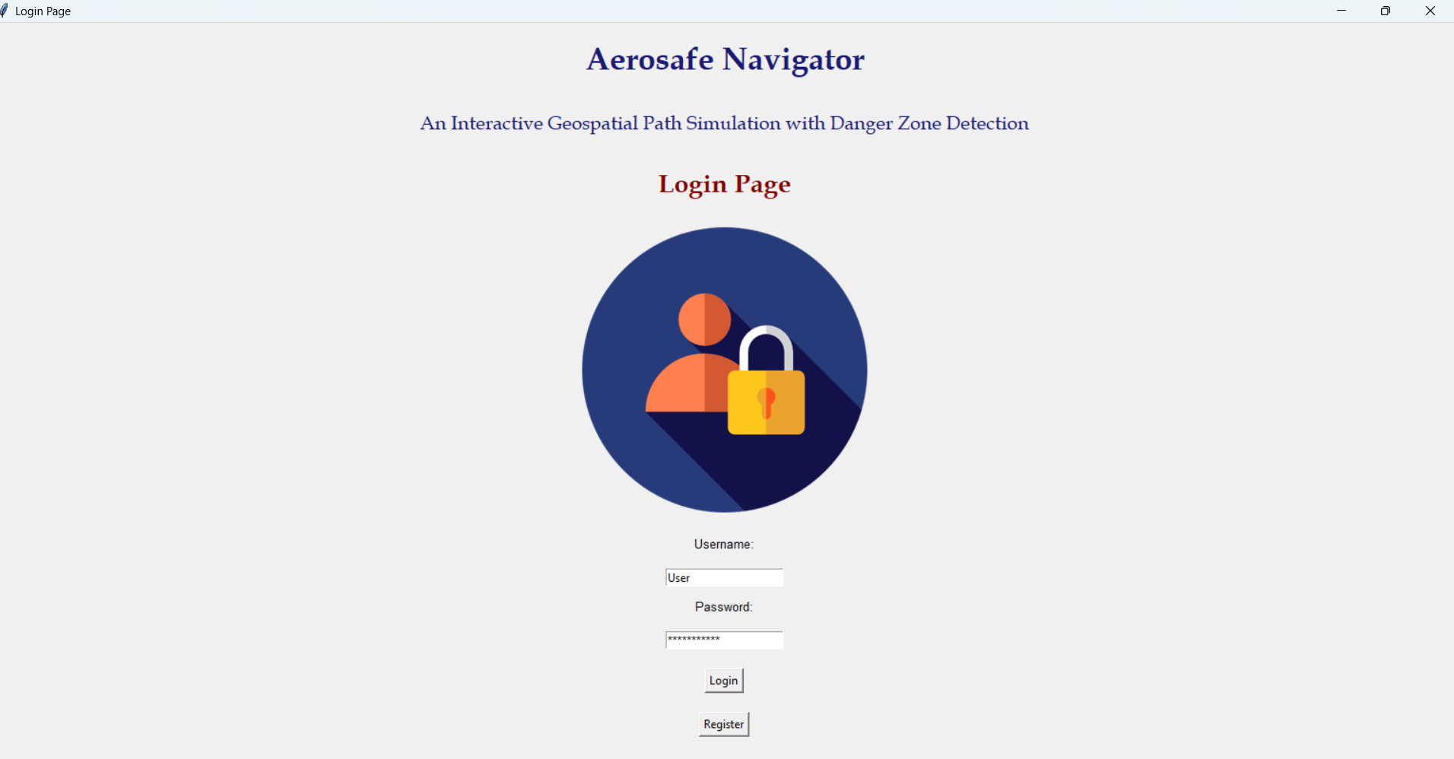
SCREENSHOTS

Slide 9
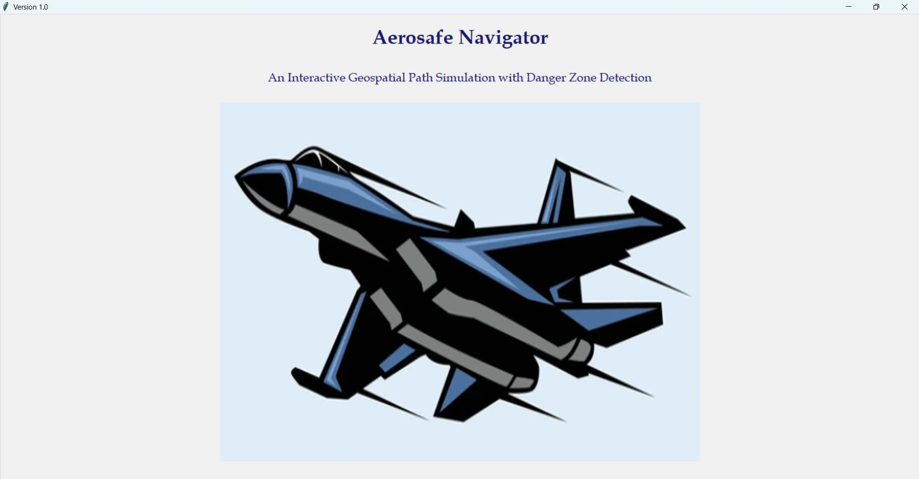
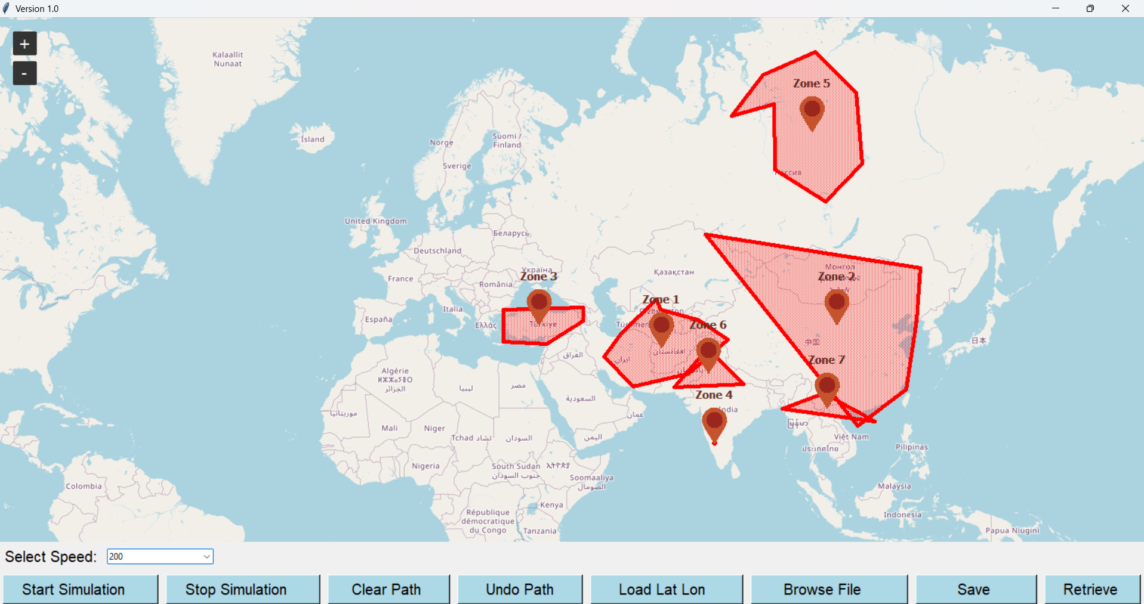

Slide 10
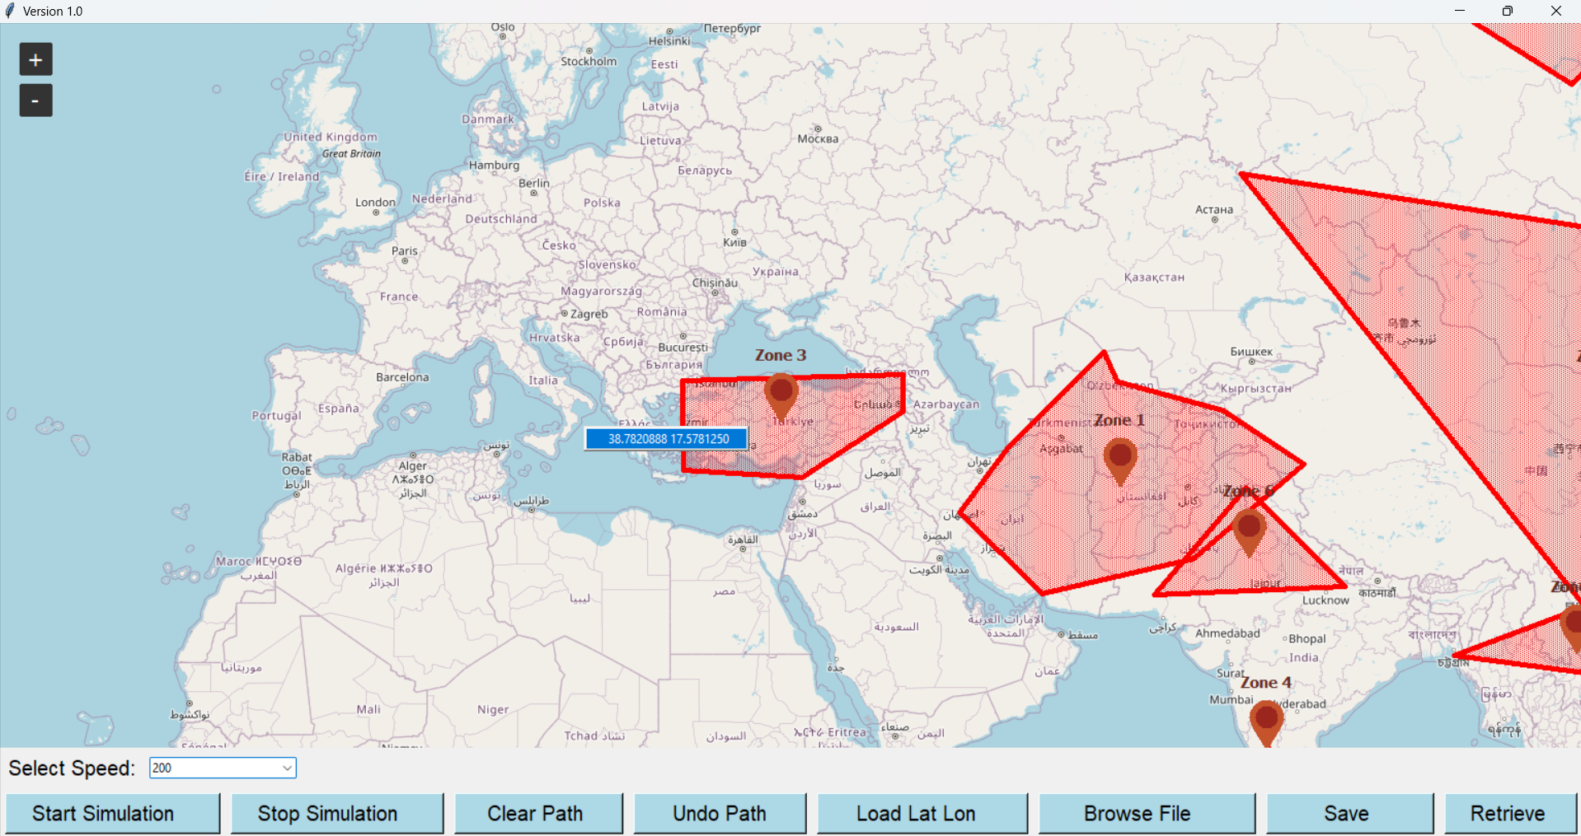
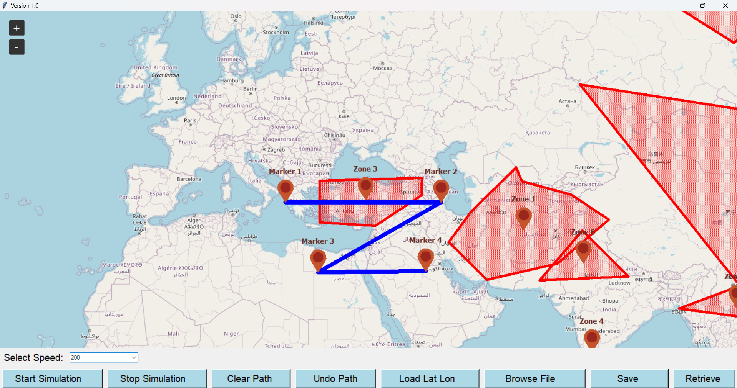

Slide 11
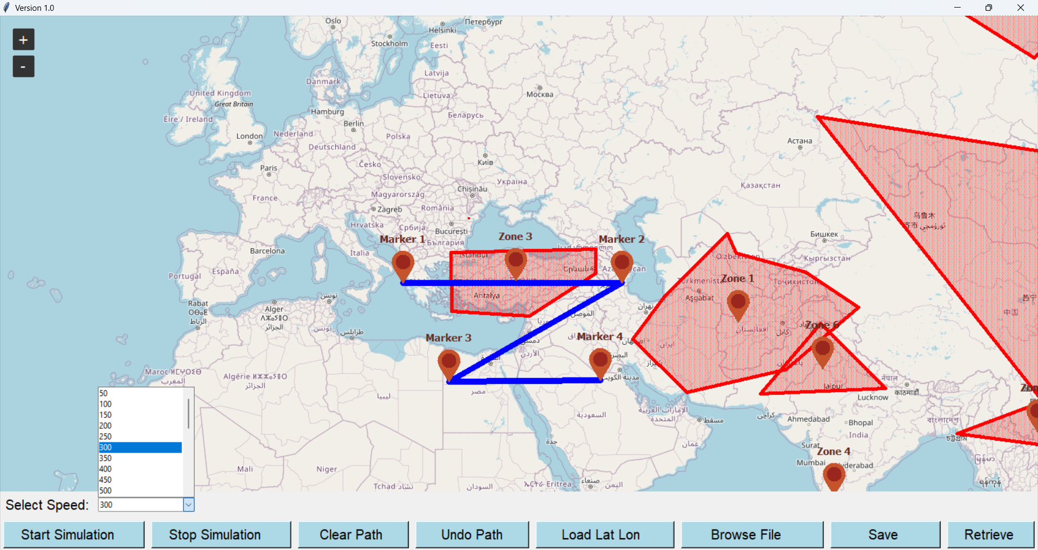
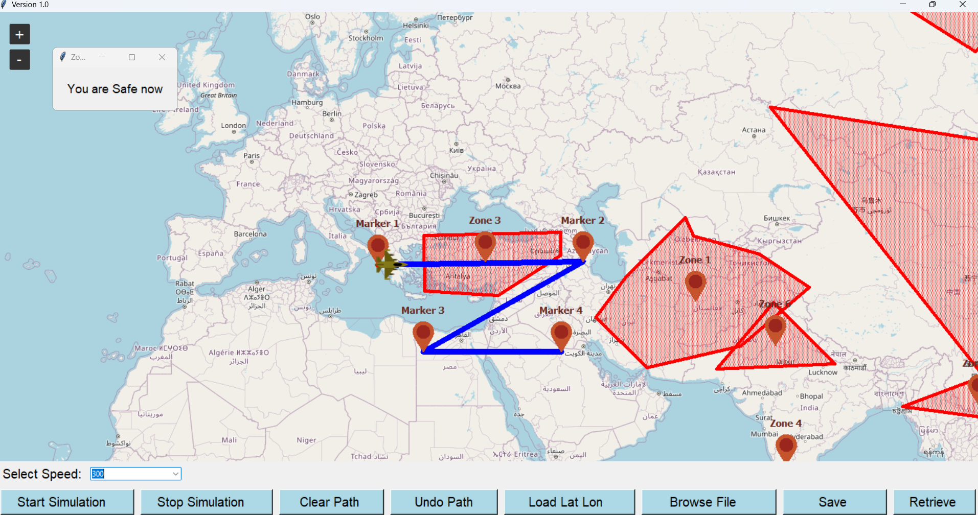

Slide 12
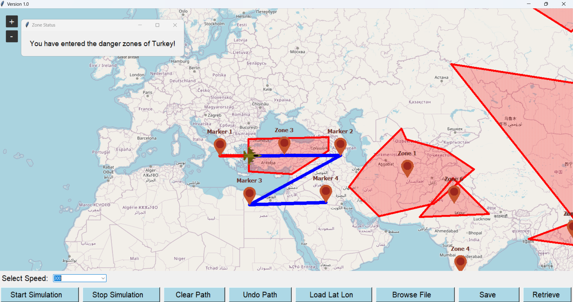
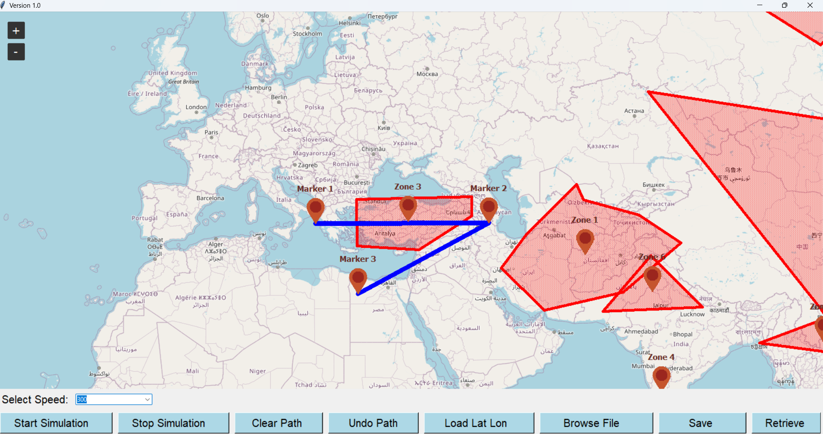

Slide 13
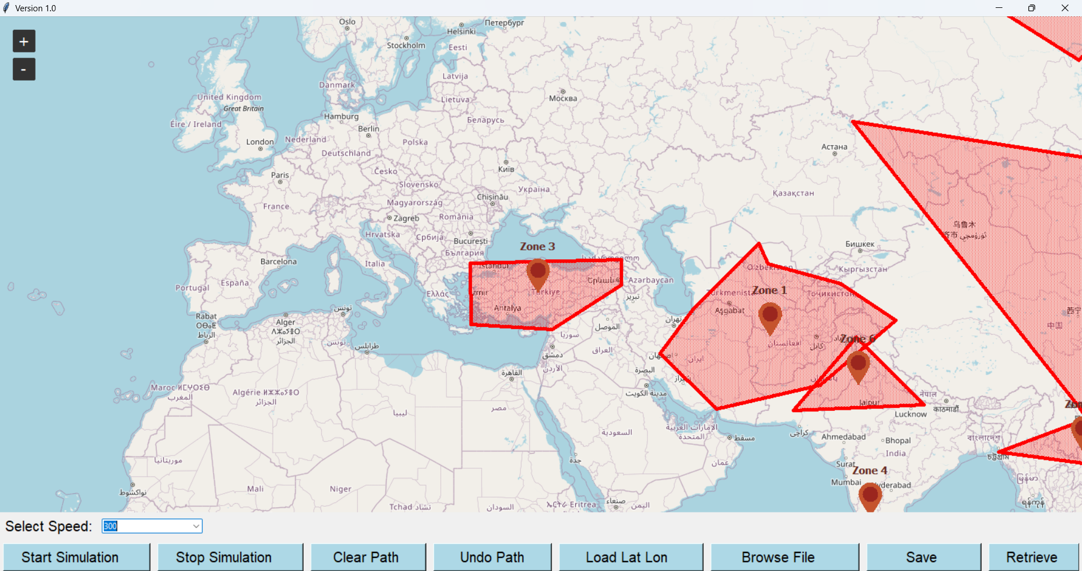
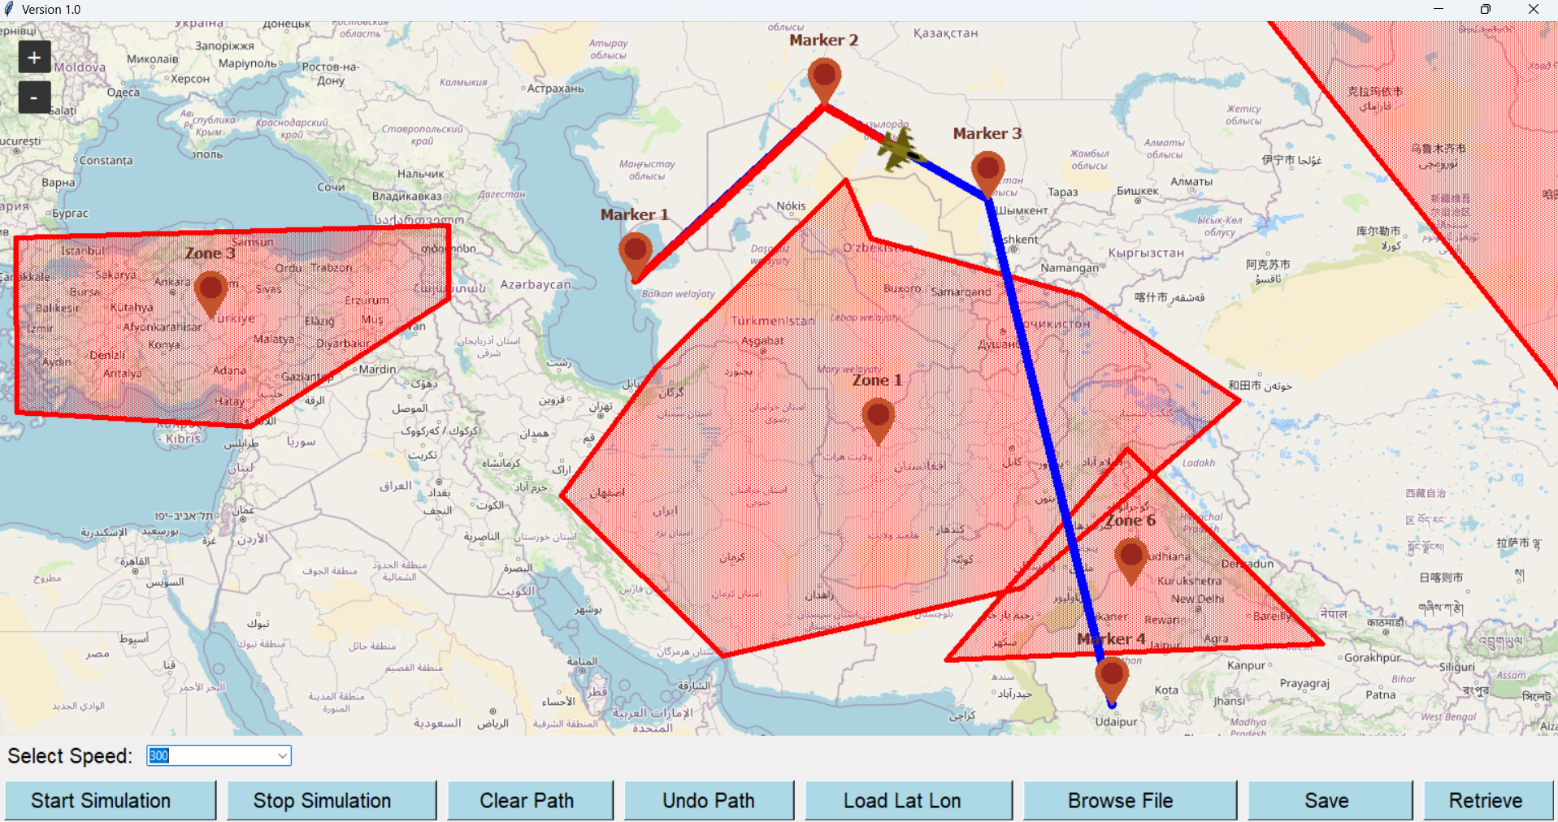

Slide 14
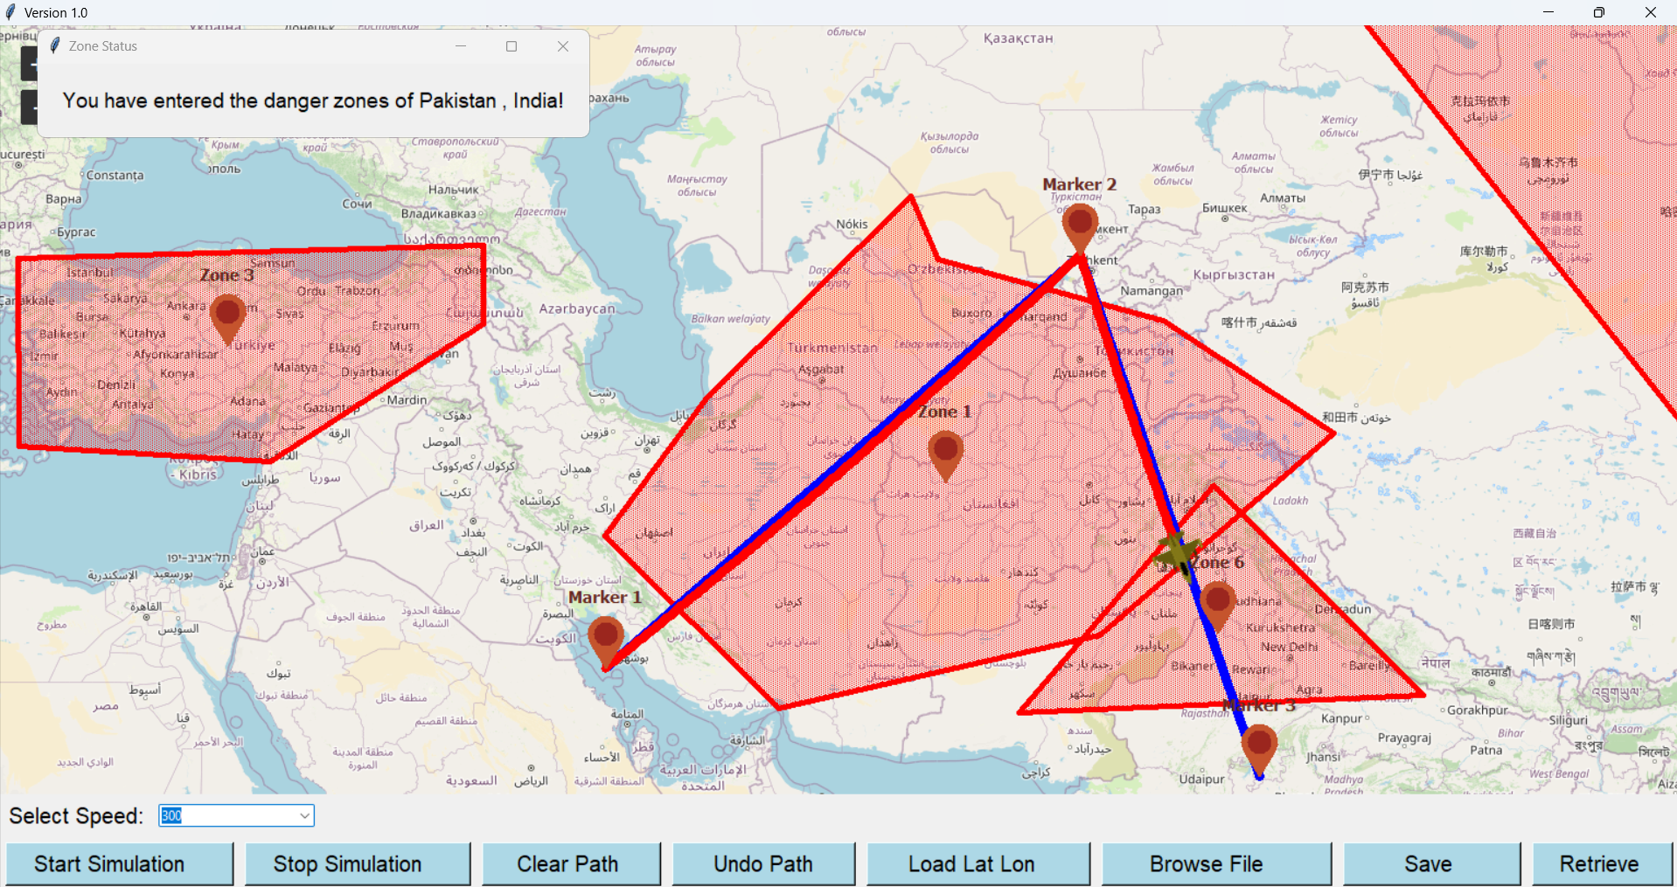
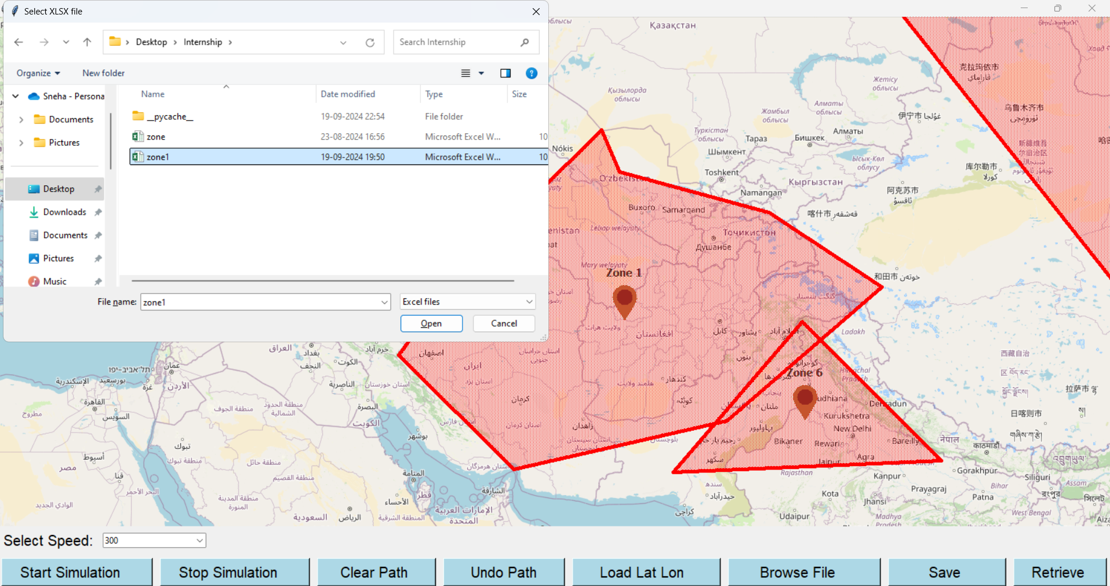

Slide 15
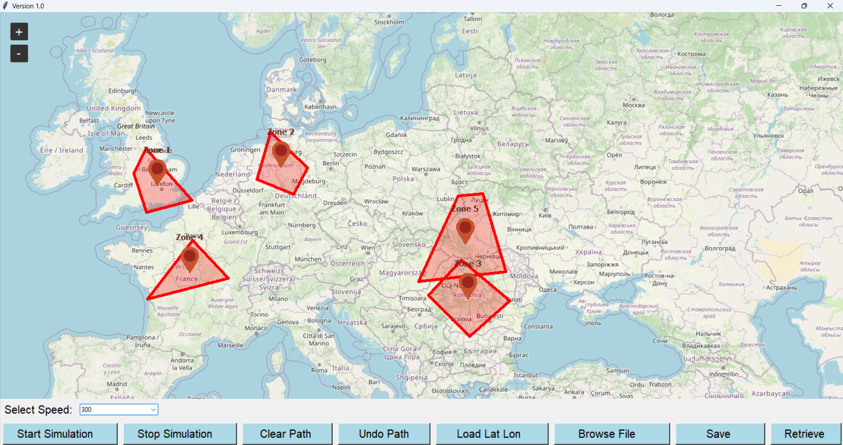
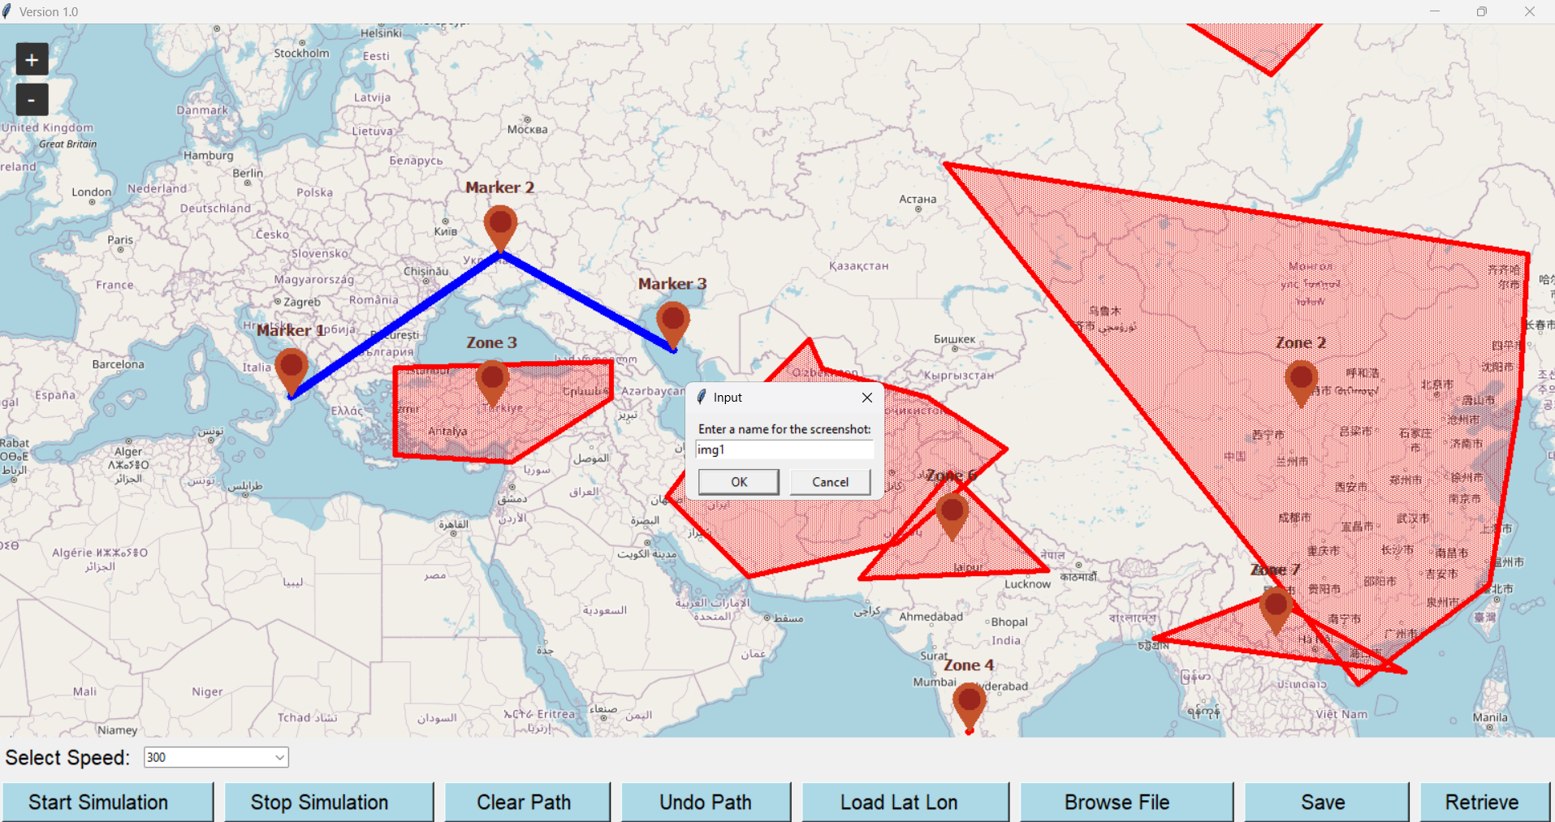

Slide 16
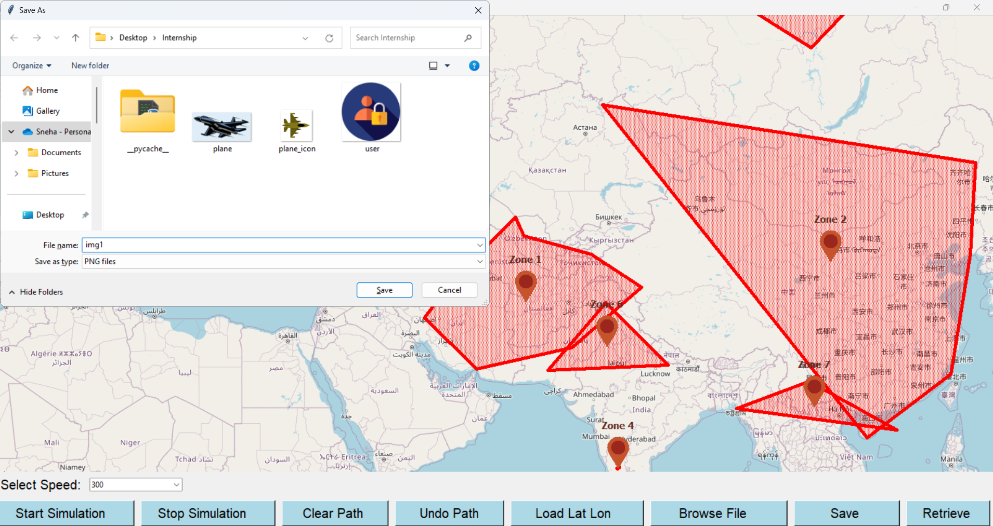
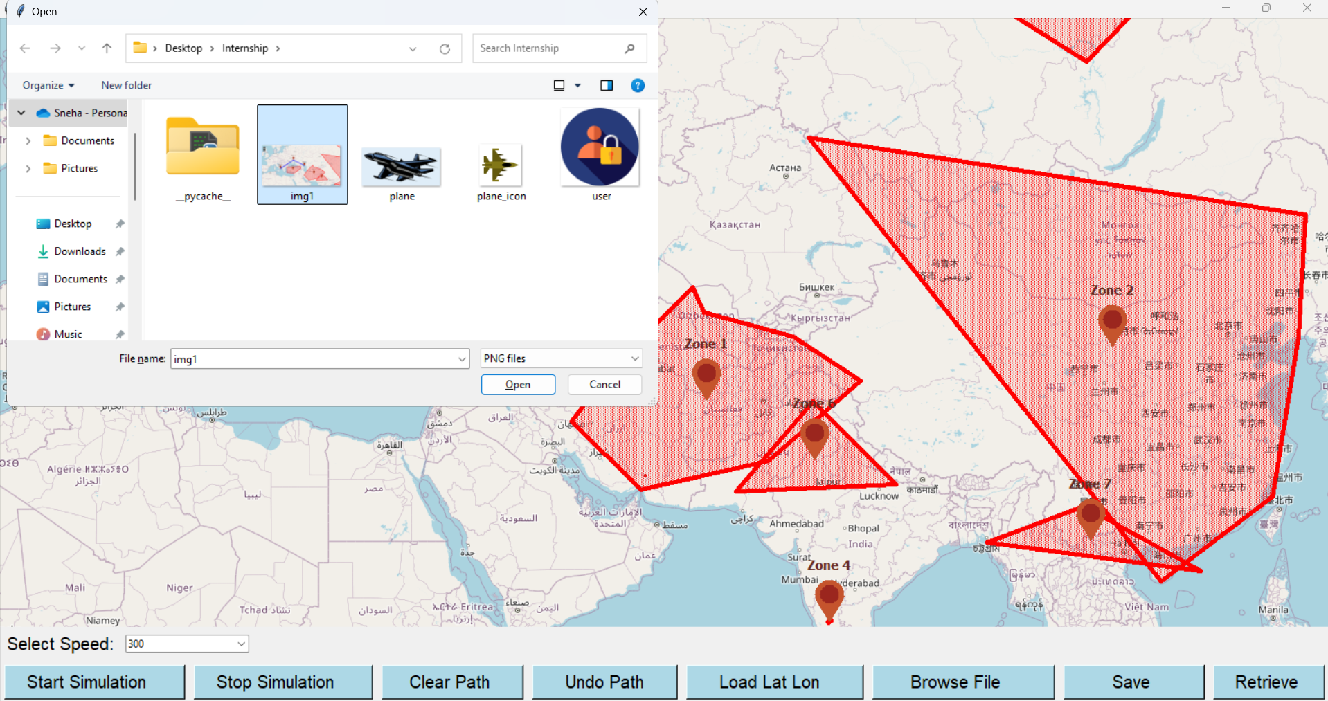

Slide 17
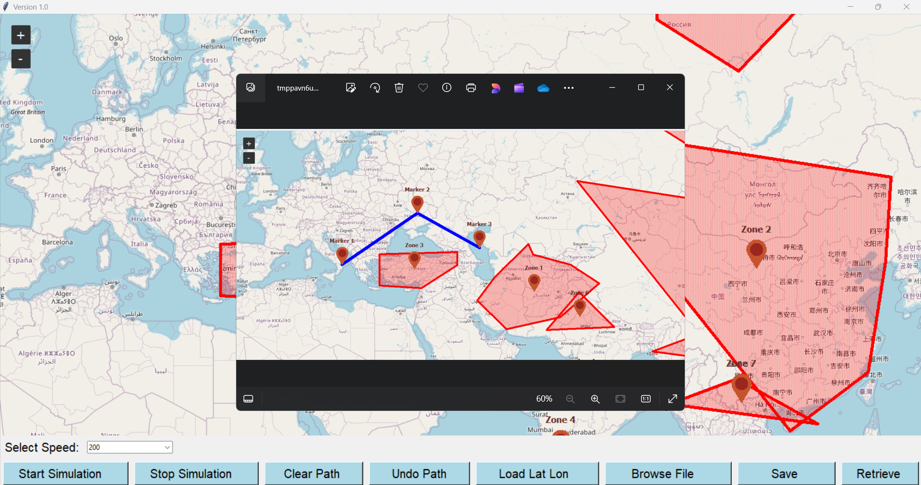

Slide 18
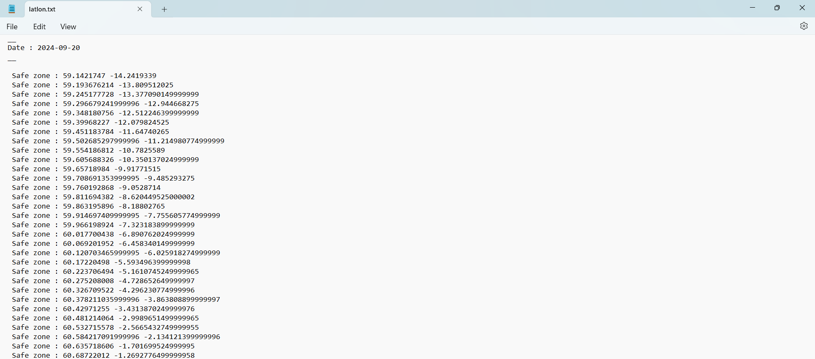
Lat Lon Text File

Slide 19
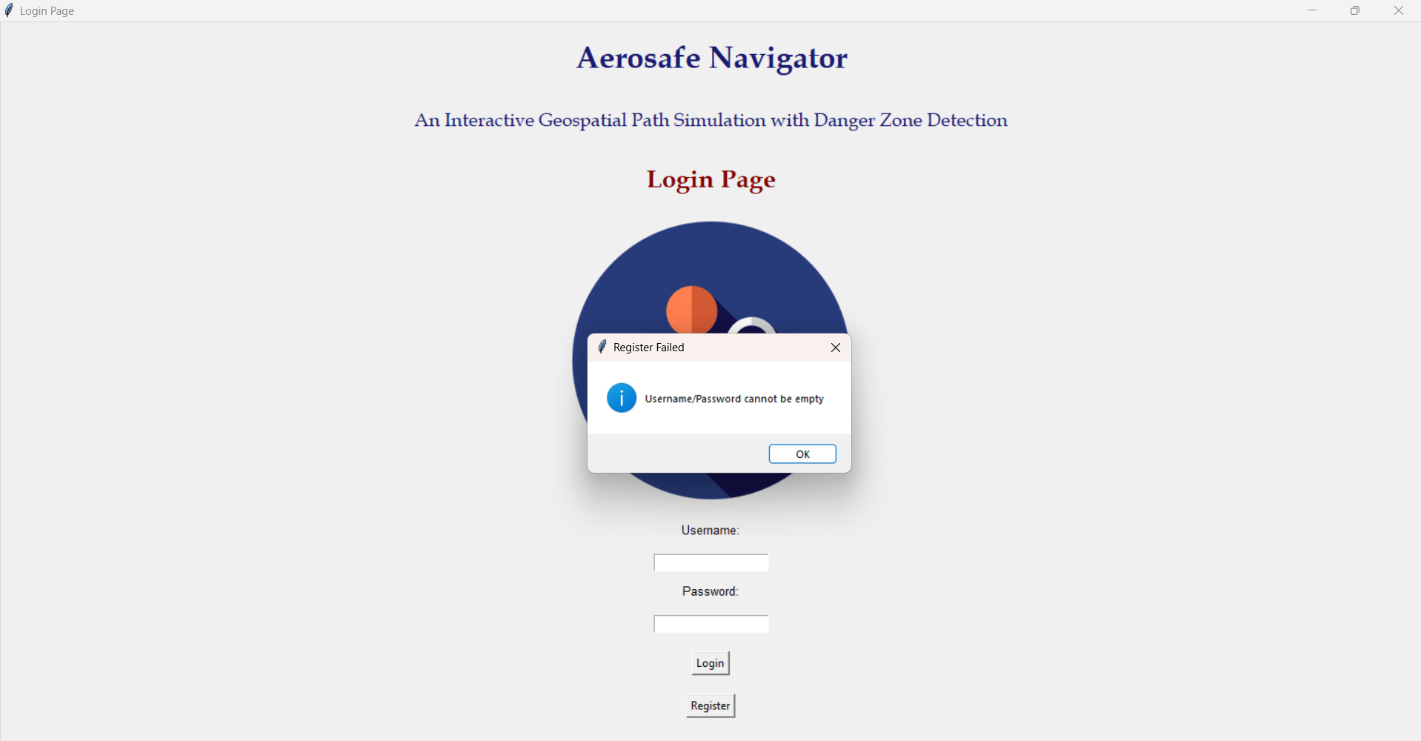
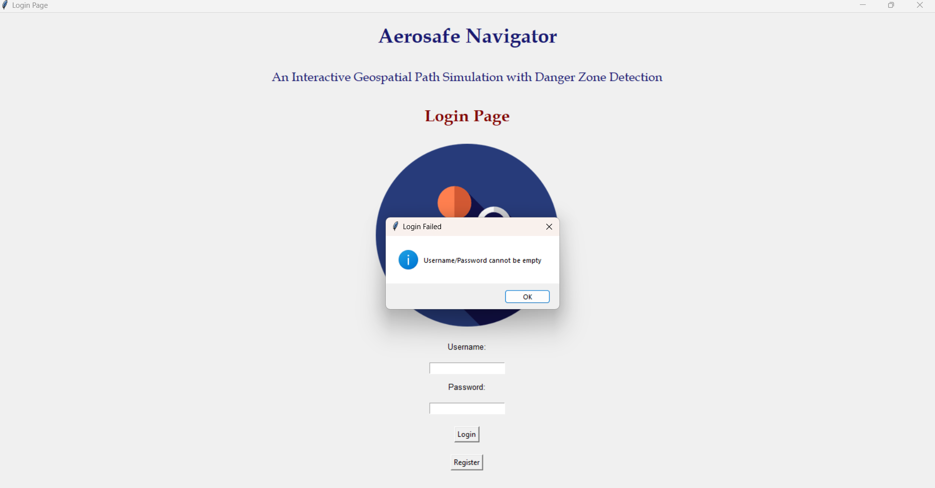
VALIDATIONS
Username/Password cannot be empty:

Slide 20
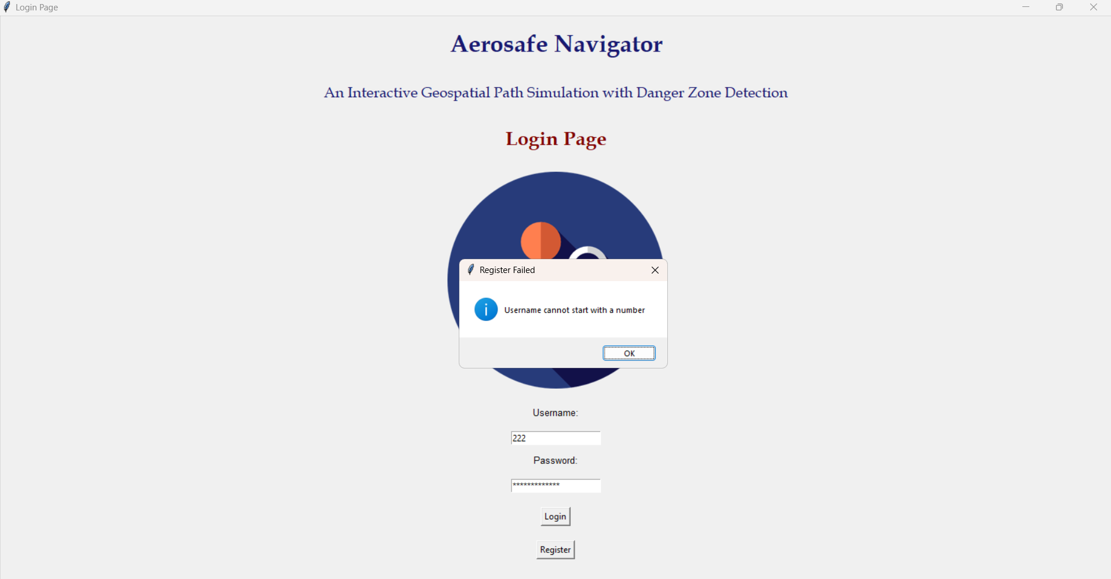
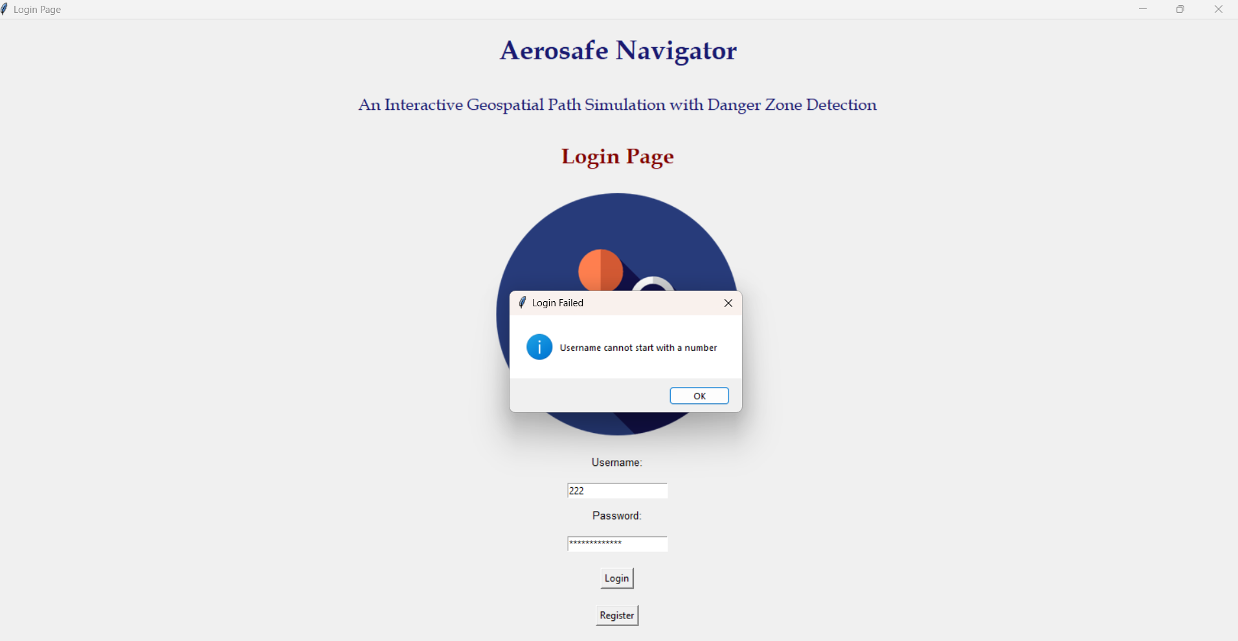
Username Validation (Username cannot start with a number):

Slide 21
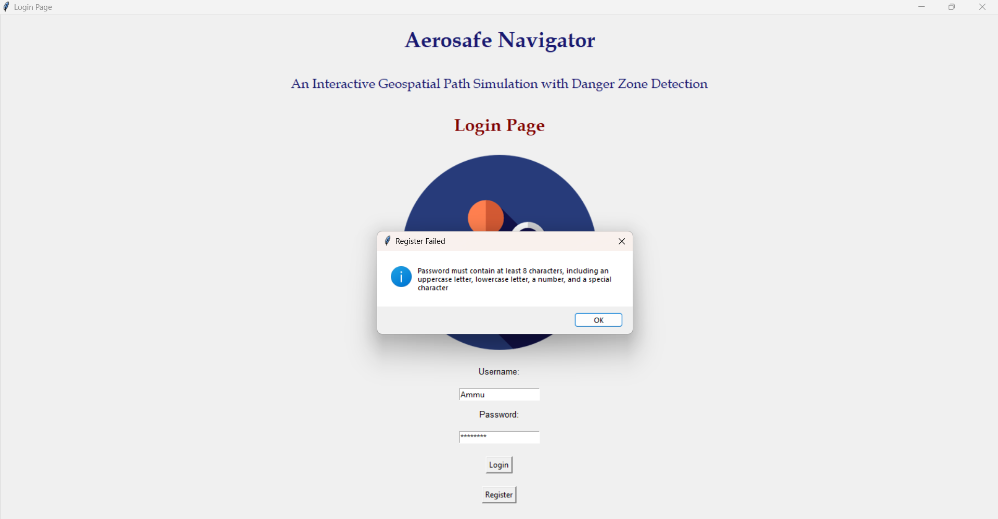
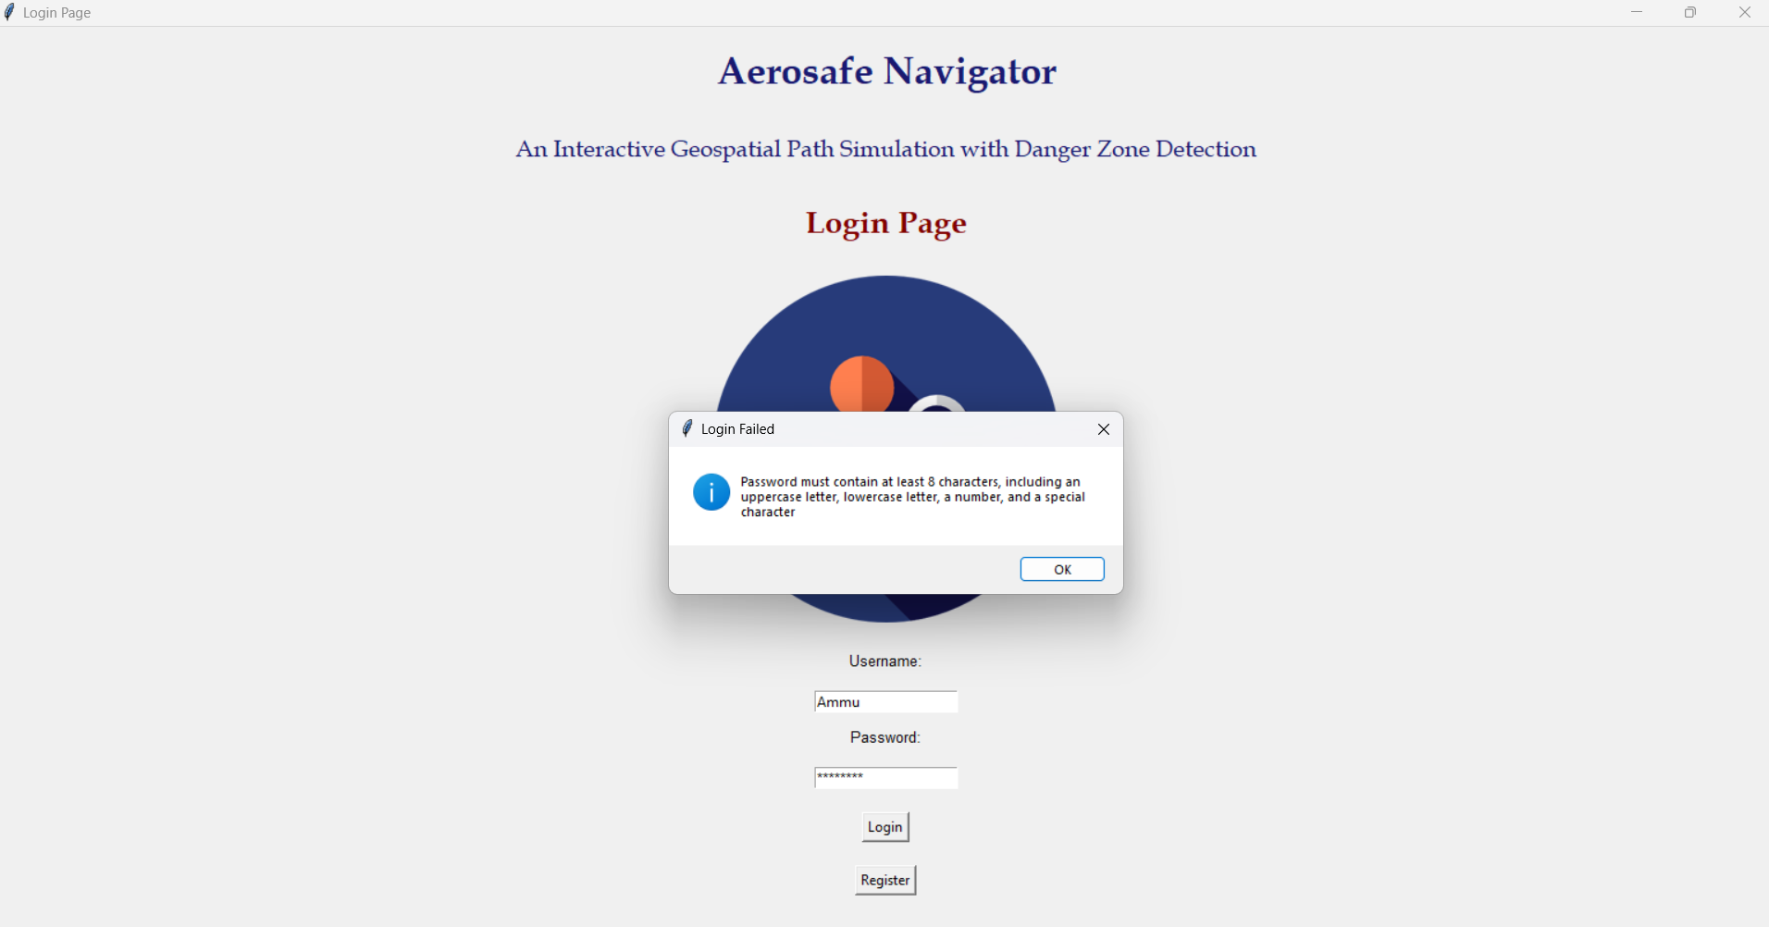
Password Validation:

Slide 22

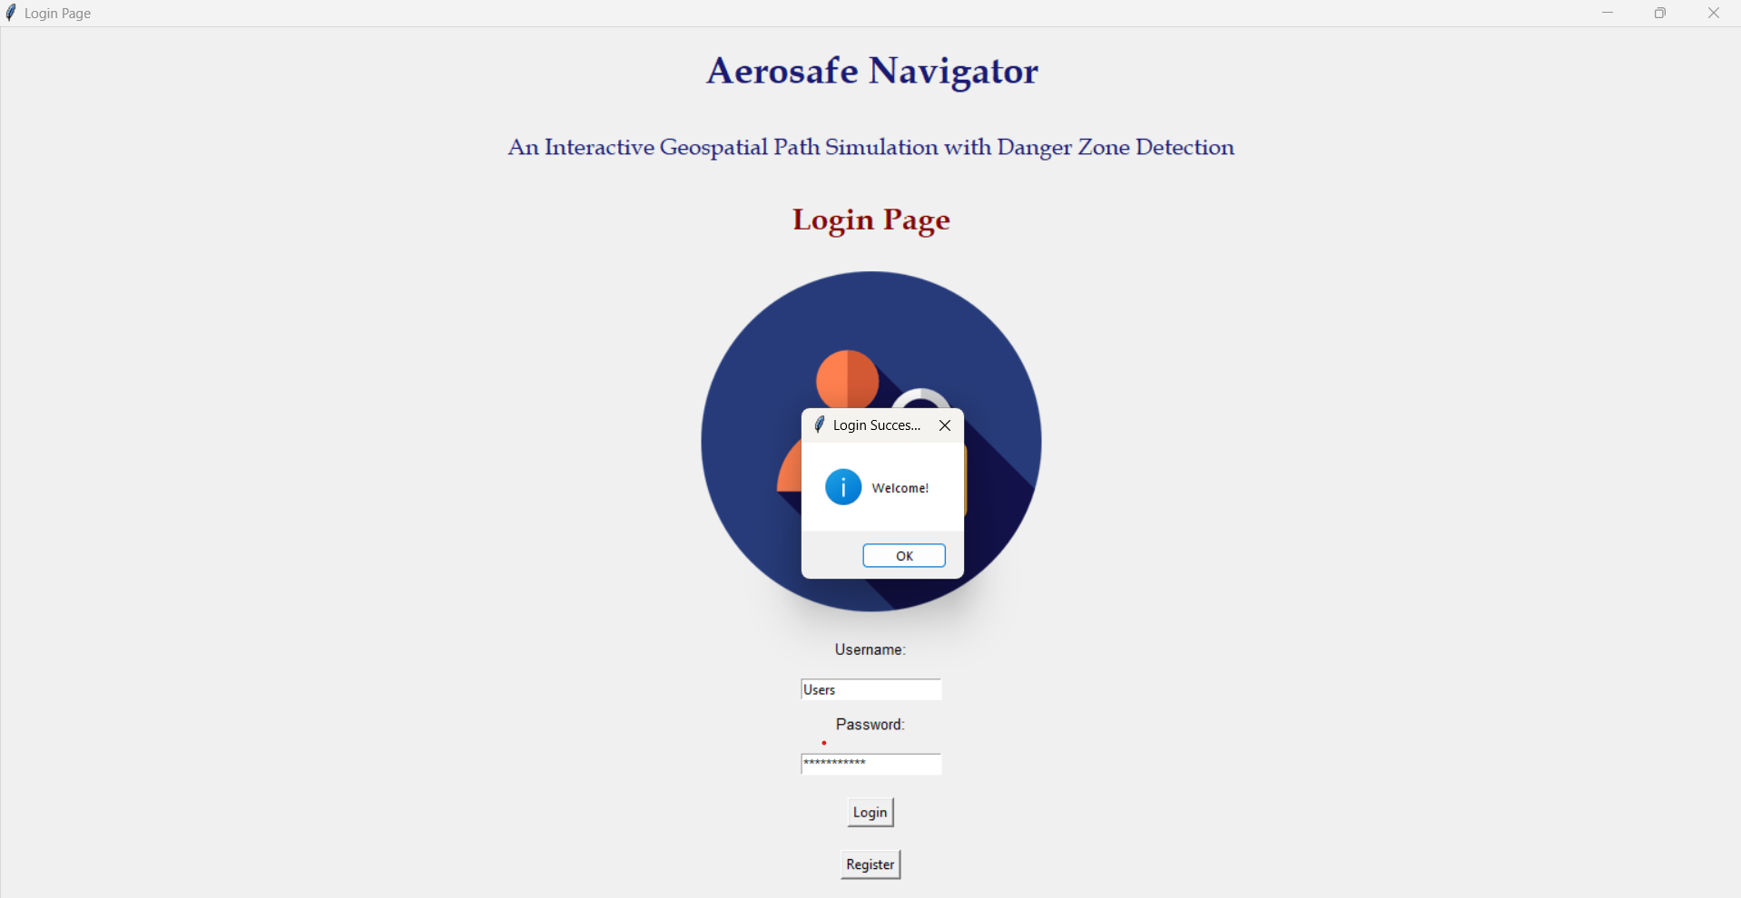
Registration Successful:
Login Successful:

Slide 23
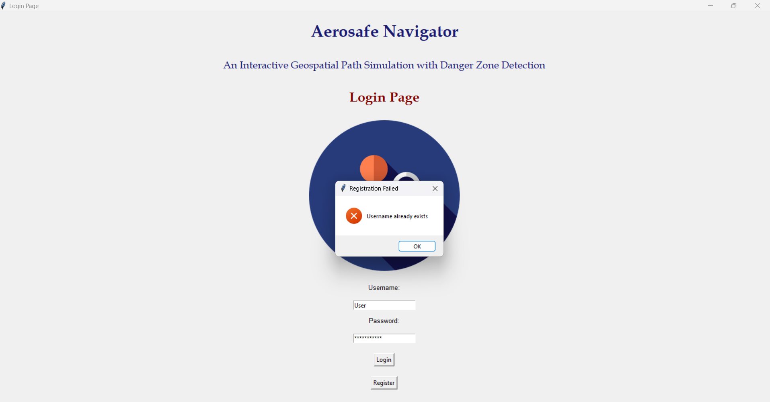
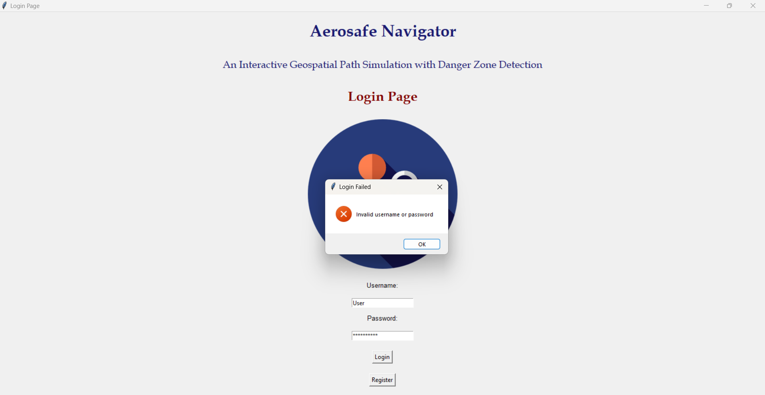
Username already exists:
Invalid Username/Password:

Slide 24
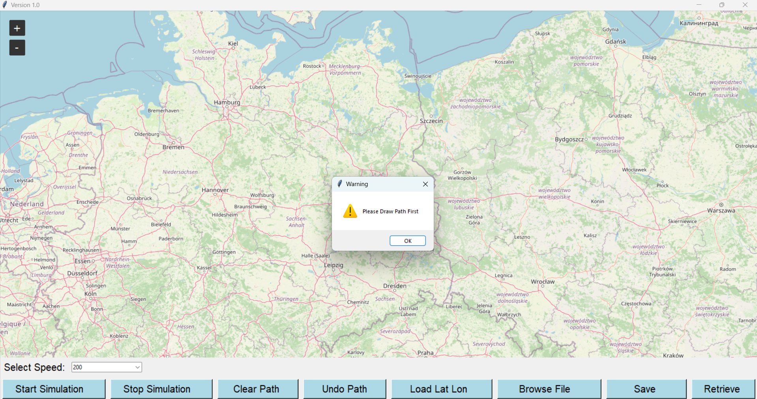
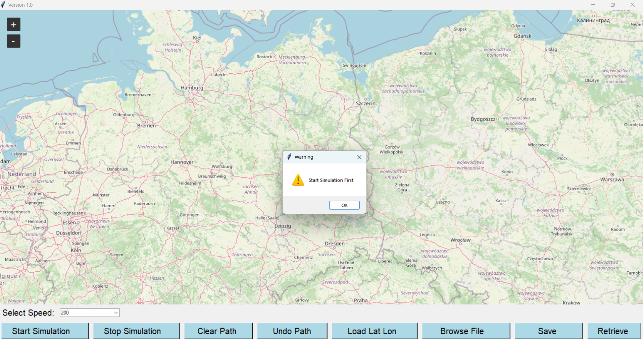
Clicking on Start Simulation without drawing any paths:
Clicking on Stop Simulation without Starting Simulation:

Slide 25


Clicking on Clear Path without Drawing any paths to clear:
Clicking on Undo Path without any Markers being plotted:

Slide 26

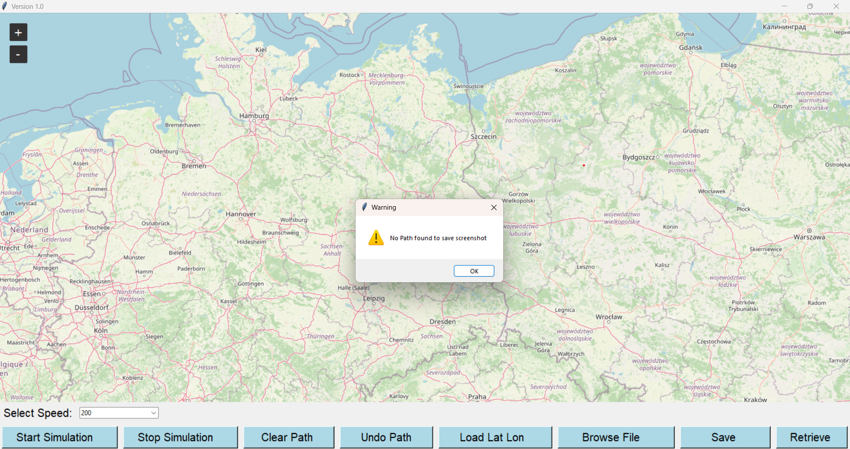
Clicking on Load Lat Lon without copying the contents:
Clicking on Save without drawing any paths to take screenshot:

Slide 27
TESTING STRATEGIES
Unit Testing:
Danger Zone Loading: Test the load_danger_zones function with valid and invalid Excel files, different data formats, and edge cases like empty or missing data.
Coordinate Validation: Create unit tests to validate the format and range of latitude and longitude coordinates.
Path Creation: Test the create_path function with different input coordinates to ensure it correctly generates path objects.
Map Interaction: Test the on_map_click function to ensure it adds points to the path correctly.
Simulation Logic: Test the move_line function with various airplane paths, speeds, and danger zone configurations to ensure it calculates positions, updates the map, and handles danger zone interactions correctly.
Audio Playback: Test the sound effects to ensure they play correctly in different scenarios.

Slide 28
Integration Testing:
Danger Zone and Path Interaction: Test if the danger zone detection works correctly when the airplane path intersects or approaches danger zones.
Simulation Speed: Test different speed settings to ensure the airplane's movement speed is accurate.
User Interface: Test all buttons, dropdowns, and other UI elements to ensure they function as expected.
Clipboard Integration: Test if pasting coordinates from the clipboard works correctly.
Screenshot Functionality: Test if screenshots are saved correctly with the expected content.
Error Handling: Test if the code handles errors gracefully (e.g., invalid file paths, invalid coordinates).

Slide 29
System Testing:
End-to-End Testing: Test the entire application from start to finish, including loading danger zones, creating airplane paths, running simulations, and interacting with the UI.
Performance Testing: Test the application's performance under different load conditions (e.g., large number of danger zones, complex airplane paths).
Compatibility Testing: Test the application on different operating systems and hardware configurations.
Usability Testing: Observe users interacting with the application to identify any usability issues or areas for improvement.

Slide 30
TEST CASES
Test Case Number | Test Case | Input | Expected Output | Actual Output | Validation | Status
1 | Login | User enters valid credentials for login | User successfully logs in and is redirected to the main interface | User successfully logs in and is redirected to the main interface | Verify that the user is logged in, the main interface loads correctly, and session data is accurate. | PASS
2 | Load Danger Zones | Valid Excel file with danger zone data | Danger zones successfully loaded and displayed on the map | Danger zones successfully loaded and displayed on the map | Verify that the correct number of danger zones are loaded and displayed, and their shapes match the data. | PASS
3 | Create Flight Path | User clicks multiple points on the map | Airplane path is drawn connecting the clicked points | Airplane path is drawn connecting the clicked points | Verify that the path is drawn correctly and the number of points in the path matches the number of clicks. | PASS
4 | Start Simulation | User clicks 'Start' button | Airplane starts moving along the defined path | Airplane starts moving along the defined path | Verify that the airplane marker moves smoothly along the path and follows the path's orientation. | PASS
5 | Pause/Resume Simulation | User clicks 'Pause' and then 'Resume' buttons | Simulation pauses and resumes | Simulation pauses and resumes | Verify that the airplane's movement stops on 'Pause' and resumes on 'Resume.' | PASS
6 | Danger Zone Detection | Airplane enters a danger zone | 'Danger Zone' message and sound alert are displayed | 'Danger Zone' message and sound alert are displayed | Verify the correct danger zone is identified and the alert message and sound are triggered. | PASS
7 | Safe Zone Detection | Airplane exits a danger zone | 'Safe Zone' message and sound alert are displayed | 'Safe Zone' message and sound alert are displayed | Verify that the safe zone is identified, and the alert message and sound are triggered. | PASS
8 | Speed Adjustment | User selects a different speed | Airplane's speed changes | Airplane's speed changes | Verify that the airplane's movement speed changes according to the user selection. | PASS
9 | Path Clearing | User clicks 'Clear Path' button | Airplane path is cleared | Airplane path is cleared | Verify that the path is removed from the map and the airplane marker resets to its initial position. | PASS
10 | Undo Path | User clicks 'Undo Path' button | Last point in the path is removed | Last point in the path is removed | Verify that the last point in the path is removed, and the path redraws accordingly. | PASS
11 | Screenshot | User clicks 'Save Screenshot' button | Screenshot is saved | Screenshot is saved | Verify that a screenshot of the map with the airplane path, airplane, and danger zones is saved. | PASS
12 | Clipboard Integration | User pastes latitude and longitude coordinates | Coordinates are added to the airplane path | Coordinates are added to the airplane path | Verify that the coordinates are added to the path, and a marker is placed at the corresponding location. | PASS
13 | Error Handling | Invalid Excel file or invalid path coordinates | Error message is displayed | Error message is displayed | Verify that an appropriate error message is displayed when invalid data is encountered. | PASS

Slide 31
CONCLUSION
Aerosafe Navigator App manages airplane path simulations and integrates with various modules like Path Manager, Simulation Manager, and Map View. This application also handles key features such as path management, simulation control and danger zone detection, with a UI Manager responsible for the user interface and interaction components like buttons, dropdowns, and login functionality. This application is designed to be modular and flexible, allowing for the smooth management of paths, danger zones, and real-time simulations, along with features such as screenshot saving and file browsing.

Slide 32
LIMITATIONS
Manual Data Entry: Users need to manually select files or input data like speed and zones. There is no automation or API integration for fetching real-time data, which could make the system less efficient for real-time applications.
Limited Cross-Platform Compatibility: The design and implementation might be focused on a desktop environment using Tkinter (which has limited features compared to more modern UI frameworks). It may not be well-suited for web or mobile environments without significant modifications.
Limited Notifications and Alert System: Although there is a method for sending alerts in case of proximity to danger zones, there is no mention of more advanced notification mechanisms (e.g., notifications based on user roles, severity levels, or external factors).
Dependency on Local Resources: The current design relies on local files (such as Excel files) and local system resources, which limits its functionality in a distributed or cloud environment. This dependency can make collaboration and scaling more challenging.

Slide 33
FUTURE ENHANCEMENTS
User-Specific Screenshot Storage: Modify the current screenshot system to save screenshots in a user’s personal storage space in the database (cloud or local). Each user will have a unique directory or database table to store their screenshots.
Restrict Screenshot Access: Implement access control rules so that users can only view or retrieve their own screenshots. When a user requests to retrieve a screenshot, the system will check the user’s ID against the ID associated with the screenshot in the database.
Screenshot Retrieval Dashboard: Provide a dashboard where users can view a list of their saved screenshots, along with details like the date and time they were taken. From this dashboard, they can download, delete, or share their screenshots, with all actions tied to their user account.
Encrypt Screenshots: Store screenshots securely by encrypting the image files or storing them in a secure cloud environment. This adds another layer of protection in case of unauthorized database access.

Slide 34
THANK YOU

